Slide 1

Measuring Quality: Time Series Analysis
A look into forecasting product quality over time via ARIMA model
Phong Ho - STAT 590

Slide 2
Agenda
Science Presentation
1.
Defining Task
2.
Model Overview
3.
Preprocessing
4.
Model Fitting
5.
Forecasting

Slide 3
Agenda
Science Presentation
1.
Defining Task
2.
Model Overview
3.
Preprocessing
4.
Model Fitting
5.
Forecasting

Slide 4

Defining Task
Science Presentation
Background
Company products quality
Statistical Process Control
Goal
Notes:
The quality of a product and service is crucial for businesses, with many having a dedicated Quality Assurance (QA) Manager or even a team. While Quality Control (QC) methods provide the statistical foundation for quality assurance, QA focuses on integrating management protocols with these statistical methods to ensure overall quality.
The company manufactures a range of products with quality control methods used throughout the process.
Statistical Process Control (SPC) is applied to monitor and assess product quality.
The goal of SPC is to drive continuous improvement in product quality over time.

Slide 5
Defining Task
Science Presentation
Task
What sort of transformation would you apply?
Fit an ARIMA model to the original and transformed data.

Slide 6
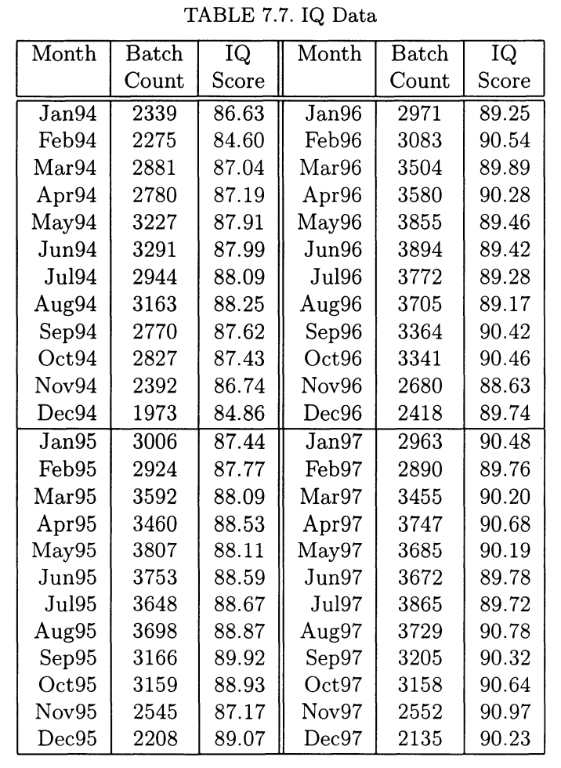
Defining Task
Science Presentation
Data
Time series Model
Monthly Data
C74.dat ( Statistical Thinking )
Quality index
Realistic improvement
Notes:
obtain a good time series model for modeling the IQ score.
Monthly data for the last four years of the AQI score for a certain product.
This dataset is also available in the file c74. dat.
Index of Quality (IQ), where 100 represents the highest quality.
It helps set realistic improvement goals for products with seasonal sales variations.

Slide 7
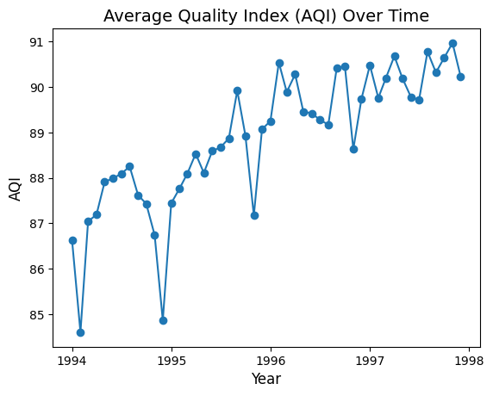
Defining Task
Science Presentation
Python

Slide 8
Agenda
Science Presentation
1.
Defining Task
2.
Model Overview
3.
Preprocessing
4.
Model Fitting
5.
Forecasting

Slide 9
Model Overview
Science Presentation
Precursor
Response and predictor
Regression
Independent error
ARIMA models
Notes:
Let Y(t) represent the response value of interest (IQ) at time t, with time measured in months.
In regression, X is the time index, and Y is the response, used to forecast Y(t+1).
Regression show that error component of models are Independent error components is not suitable for time progressing processes.
ARIMA models, which are better suited for time-series forecasting.

Slide 10
Model Overview
Science Presentation
ARIMA

Slide 11
Model Overview
Science Presentation
ARIMA
AutoRegressive
Integrated
Moving Average

Slide 12
Model Overview
Science Presentation
AutoRegressive (AR)
Autoregression
Linear combination
Time Series, Lag Coefficient, Error
Lag order
https://github.com/egorhowell/Youtube/blob/main/Time-Series-Crash-Course/16.%20Moving%20Average%20Models.ipynb
Notes:
Autoregression forecasts future values using a linear combination of previously observed values.
The model includes y (the time series), ϕ (lag coefficients), and ε (error term, often normally distributed).
p represents the number of lagged components, also known as the order of the model.

Slide 13
Model Overview
Science Presentation
Integrated (I)
Stationarity
Constant mean and variance
Differencing
Removes trends and stabilization
Transformation
Notes:
Order of differencing steps required to make a time series stationary.
Stationarity means the time series has a constant mean and variance, with statistical properties that don't change over time.
Differencing removes trends and stabilizes the mean, often making the series stationary after a single differencing step.
To achieve constant variance, additional transformations like the logarithmic or Box-Cox transforms may be necessary, beyond differencing.

Slide 14
Model Overview
Science Presentation
Moving Average (MA)
Moving Average
Time series, Mean, Lag error coefficients
Forecast error
Lag error coefficients
Notes:
Moving Average forecasts future values using past forecast errors instead of actual observed values.
The model includes y (the time series), μ (the mean), and θ (the coefficients of lagged forecast errors).
ε represents the forecast error terms.
q is the number of lagged error components, also known as the order of the moving average part of the model.

Slide 15
Model Overview
Science Presentation
Final Model
ARIMA
y'
Linear summation
Short handed notation: ARIMA(p, d, q),
Notes:
The full ARIMA model combines the autoregression, integration (differencing), and moving average components.
The equation uses y', the differenced version of the time series, to account for stationarity.
The ARIMA model is a linear summation of the three components (autoregression, integration, and moving average).
The model is written as ARIMA(p, d, q), where p is the order of autoregressors, d is the order of differencing, and q is the order of the moving average.

Slide 16
Agenda
Science Presentation
1.
Defining Task
2.
Model Overview
3.
Preprocessing
4.
Model Fitting
5.
Forecasting

Slide 17

Preprocessing
Science Presentation
Seasonal Decomposition
Trend
Seasonal
Residual
Notes:
Seasonal Decomposition breaks a time series into trend, seasonal, and residual components.
The trend component captures the long-term movement in the data, showing overall direction.
The seasonal component reflects regular, repeating patterns or cycles within specific time intervals.
The residual component represents the random noise or irregular variations not explained by the trend or seasonality.

Slide 18
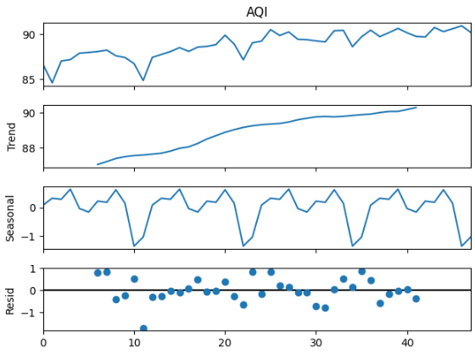
Preprocessing
Science Presentation

Slide 19
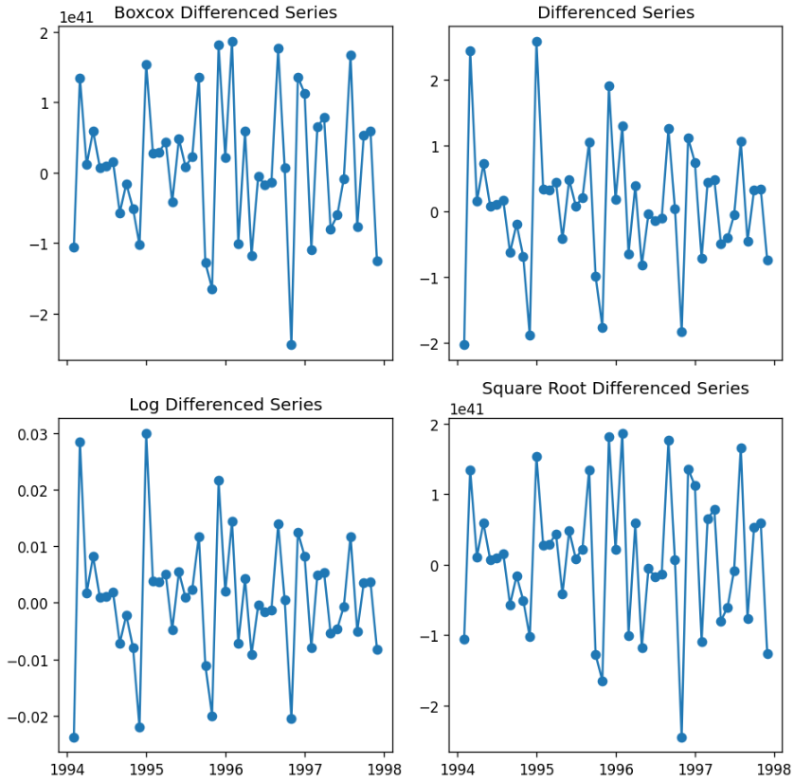
Preprocessing
Science Presentation
Differencing & Transformations

Slide 20


Preprocessing
Science Presentation
Augmented Dickey-Fuller (ADF) test
Goal
Hypothesis
p-value
Original, Boxcox, Log, Square root
Notes:
The goal of the ADF test is to determine if a time series is stationary.
The null hypothesis of the ADF test is that the data is not stationary.
The alternative hypothesis is that the data is stationary.
A p-value less than 0.05 provides strong evidence to reject the null hypothesis, indicating that the data is stationary.
Box-cox had lowest p-value, but not the best transformation explained later
David Dickey and Wayne Fuller

Slide 21
Preprocessing
Original ADI
------------------
ADF Statistic: -1.8071834692874549
P-Value: 0.3769011778347431
Critical Values:
1%: -3.59
5%: -2.93
10%: -2.60
------------------
Log Difference ADI
------------------
ADF Statistic: -4.52850918420652
P-Value: 0.00017458598579492832
Critical Values:
1%: -3.60
5%: -2.93
10%: -2.60
------------------
Boxcox Difference ADI
------------------
ADF Statistic: -7.224591308791732
P-Value: 2.068868377690321e-10
Critical Values:
1%: -3.58
5%: -2.93
10%: -2.60
------------------
Sqrt Differenced ADI
------------------
ADF Statistic: -4.5379180734463915
P-Value: 0.0001678394868607654
Critical Values:
1%: -3.60
5%: -2.93
10%: -2.60
------------------
Science Presentation
Notes:
The goal of the ADF test is to determine if a time series is stationary.
The null hypothesis of the ADF test is that the data is not stationary.
The alternative hypothesis is that the data is stationary.
A p-value less than 0.05 provides strong evidence to reject the null hypothesis, indicating that the data is stationary.
Box-cox had lowest p-value, but not the best transformation explained later

Slide 22
Agenda
Science Presentation
1.
Defining Task
2.
Model Overview
3.
Preprocessing
4.
Model Fitting
5.
Forecasting

Slide 23
Model Fitting
Science Presentation
Recall:
Notes:
p is determined by examining the PACF (Partial Autocorrelation Function) plot. The PACF shows the correlation between the series and its lag, after excluding the influence of intermediate lags. The optimal value for p is typically the point where the PACF cuts off (i.e., where the correlation becomes insignificant).
q is determined by analyzing the ACF (Autocorrelation Function) plot, which measures the correlation between the series and its lag without excluding intermediate lags. The value of q is typically chosen based on where the ACF cuts off or where the significant lags end.

Slide 24
Model Fitting
Science Presentation
Autocorrelation (ACF)
Autocorrelation, sometimes known as serial correlation in the discrete time case, measures the correlation of a signal with a delayed copy of itself.
Partial autocorrelation (PACF)
partial correlation of a stationary time series with its own lagged values, regressed the values of the time series at all shorter lags.
https://en.wikipedia.org/wiki/Autocorrelation & https://en.wikipedia.org/wiki/Partial_autocorrelation_function#:~:text=In%20time%20series%20analysis%2C%20the,series%20at%20all%20shorter%20lags.
Notes:
Correlation
Autocorrelation measures the correlation of a time series with itself at different time points (lags). It helps assess how a time series is related to its past values.
A value of 1 indicates perfect positive correlation, -1 indicates perfect negative correlation, and 0 indicates no correlation. For example, autocorrelation at lag 1 measures the correlation between yty_tyt​ and yt−1y_{t-1}yt−1​.
Partial
Measures the direct correlation between values at two different time lags, while removing the influence of any intermediate lags.
For a lag of 2, partial autocorrelation shows the correlation between the series at time t and t-2, after accounting for the effect of the series at time t-1.

Slide 25
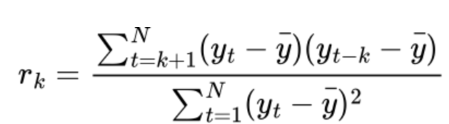
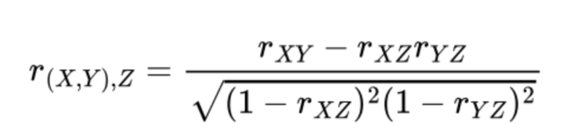
Model Fitting
Science Presentation
Autocorrelation (ACF)
Partial autocorrelation (PACF)
Notes:
Correlation
Autocorrelation measures the correlation of a time series with itself at different time points (lags). It helps assess how a time series is related to its past values.
A value of 1 indicates perfect positive correlation, -1 indicates perfect negative correlation, and 0 indicates no correlation. For example, autocorrelation at lag 1 measures the correlation between yty_tyt​ and yt−1y_{t-1}yt−1​.
Partial
Measures the direct correlation between values at two different time lags, while removing the influence of any intermediate lags.
For a lag of 2, partial autocorrelation shows the correlation between the series at time t and t-2, after accounting for the effect of the series at time t-1.

Slide 26
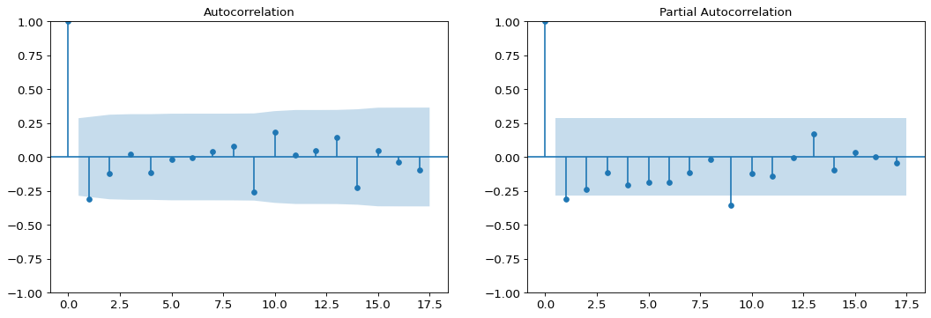
Model Fitting
Science Presentation
Original AQI with 1 order differencing
Notes:
p is determined by examining the PACF (Partial Autocorrelation Function) plot. The PACF shows the correlation between the series and its lag, after excluding the influence of intermediate lags. The optimal value for p is typically the point where the PACF cuts off (i.e., where the correlation becomes insignificant).
q is determined by analyzing the ACF (Autocorrelation Function) plot, which measures the correlation between the series and its lag without excluding intermediate lags. The value of q is typically chosen based on where the ACF cuts off or where the significant lags end.

Slide 27
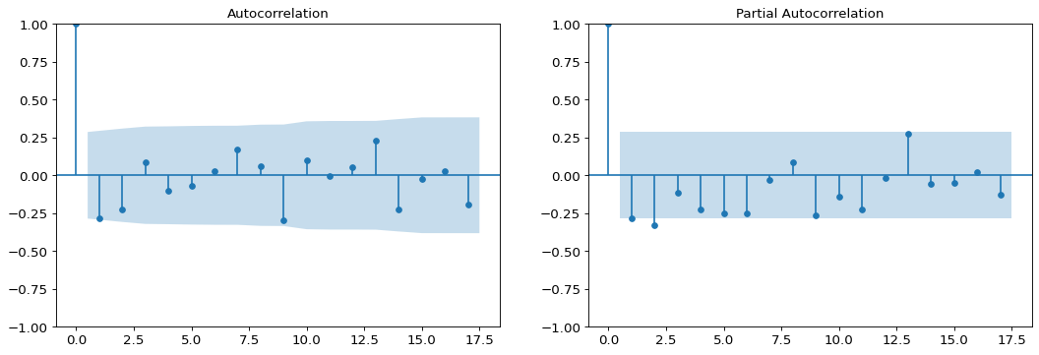
Model Fitting
Science Presentation
Boxcox transformed AQI with 1 order differencing

Slide 28
Model Fitting
Original AQI with 1 order differencing
Science Presentation
SARIMAX Results
==============================================================================
Dep. Variable: AQI No. Observations: 47
Model: ARIMA(1, 1, 1) Log Likelihood -59.627
Date: Sat, 01 Mar 2025 AIC 125.254
Time: 18:25:15 BIC 130.740
Sample: 0 HQIC 127.309
- 47
Covariance Type: opg
==============================================================================
coef std err z P>|z| [0.025 0.975]
------------------------------------------------------------------------------
ar.L1 0.3814 0.230 1.656 0.098 -0.070 0.833
ma.L1 -0.7511 0.212 -3.546 0.000 -1.166 -0.336
sigma2 0.7771 0.164 4.733 0.000 0.455 1.099
===================================================================================
Ljung-Box (L1) (Q): 0.01 Jarque-Bera (JB): 4.02
Prob(Q): 0.92 Prob(JB): 0.13
Heteroskedasticity (H): 0.34 Skew: -0.53
Prob(H) (two-sided): 0.05 Kurtosis: 3.99
===================================================================================

Slide 29

Model Fitting
Science Presentation
AIC (Akaike Information Criterion) & BIC (Bayesian Information Criterion)
SARIMAX Results
==============================================================================
Dep. Variable: AQI No. Observations: 47
Model: ARIMA(1, 1, 1) Log Likelihood -59.627
Date: Sat, 01 Mar 2025 AIC 125.254
Time: 18:25:15 BIC 130.740
Sample: 0 HQIC 127.309
- 47
Covariance Type: opg
==============================================================================
coef std err z P>|z| [0.025 0.975]
------------------------------------------------------------------------------
ar.L1 0.3814 0.230 1.656 0.098 -0.070 0.833
ma.L1 -0.7511 0.212 -3.546 0.000 -1.166 -0.336
sigma2 0.7771 0.164 4.733 0.000 0.455 1.099

Slide 30
Model Fitting
Boxcox AQI with 1 order differencing
Science Presentation
SARIMAX Results
==============================================================================
Dep. Variable: AQI_boxcox No. Observations: 47
Model: ARIMA(1, 1, 1) Log Likelihood -4404.220
Date: Sat, 01 Mar 2025 AIC 8814.440
Time: 18:25:20 BIC 8819.926
Sample: 0 HQIC 8816.495
- 47
Covariance Type: opg
==============================================================================
coef std err z P>|z| [0.025 0.975]
------------------------------------------------------------------------------
ar.L1 0.3698 0.314 1.176 0.239 -0.246 0.986
ma.L1 -0.7175 0.250 -2.866 0.004 -1.208 -0.227
sigma2 8.489e+81 3.47e-84 2.44e+165 0.000 8.49e+81 8.49e+81
===================================================================================
Ljung-Box (L1) (Q): 0.40 Jarque-Bera (JB): 0.91
Prob(Q): 0.53 Prob(JB): 0.63
Heteroskedasticity (H): 1.37 Skew: -0.34
Prob(H) (two-sided): 0.55 Kurtosis: 2.93
===================================================================================

Slide 31


Model Fitting
Science Presentation
The model
Original ARIMA(1, 1, 1)
Boxcox ARIMA(1,1,1)
Notes:
AR(1) coefficient ϕ1=0.3101\phi_1 = 0.3101ϕ1​=0.3101: This means that the previous value of the differenced series (yt−1′y_{t-1}'yt−1′​) has a positive relationship with the current value.
MA(1) coefficient θ1=−0.7492\theta_1 = -0.7492θ1​=−0.7492: This means that the previous error term (ϵt−1\epsilon_{t-1}ϵt−1​) has a negative influence on the current value of the differenced series.
Sigma2 (Error Variance) σ2=0.7747\sigma^2 = 0.7747σ2=0.7747: This is the variance of the residuals (errors). A higher value of sigma2 indicates larger variability in the errors.

Slide 32
Agenda
Science Presentation
1.
Defining Task
2.
Model Overview
3.
Preprocessing
4.
Model Fitting
5.
Forecasting

Slide 33
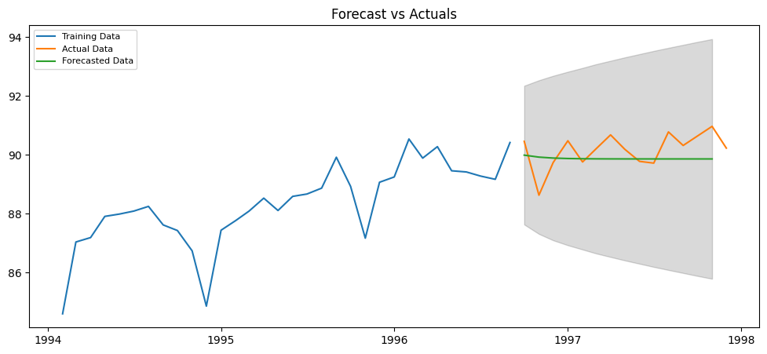
Model Forecast
Science Presentation
Figure 1: Arima forecast for original AQI

Slide 34
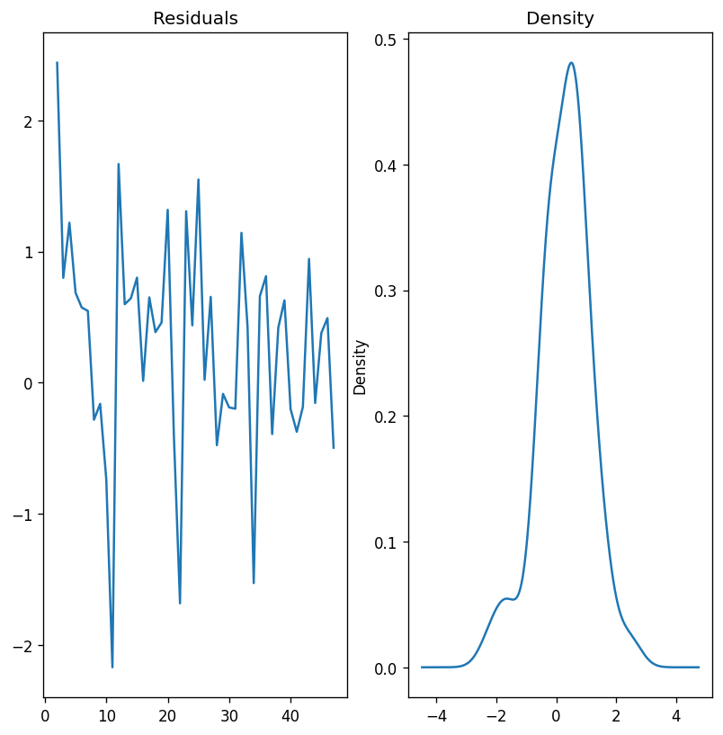
Model Forecast
Science Presentation
Figure 1: Original AQI Residual

Slide 35
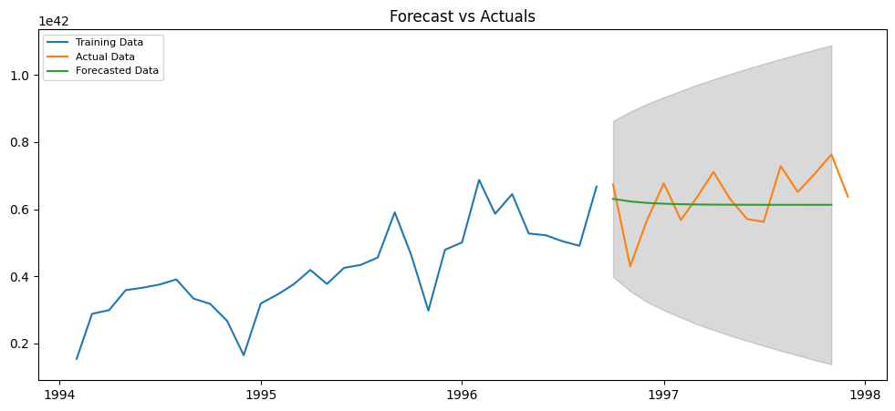
Model Forecast
Science Presentation
Figure 1: Arima forecast for boxcox AQI

Slide 36
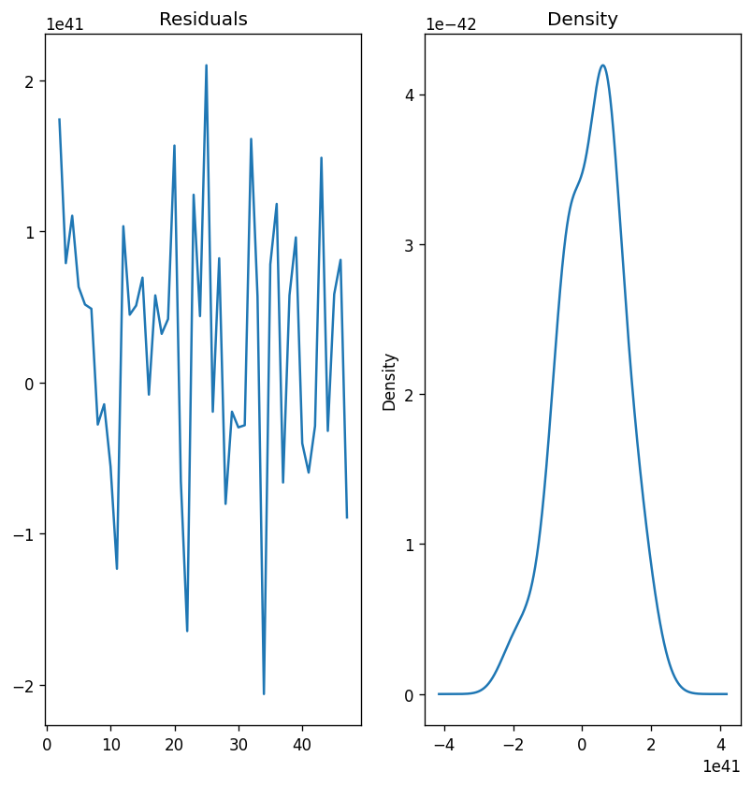
Model Forecast
Science Presentation
Figure 1: Boxcox AQI Residual

Slide 37
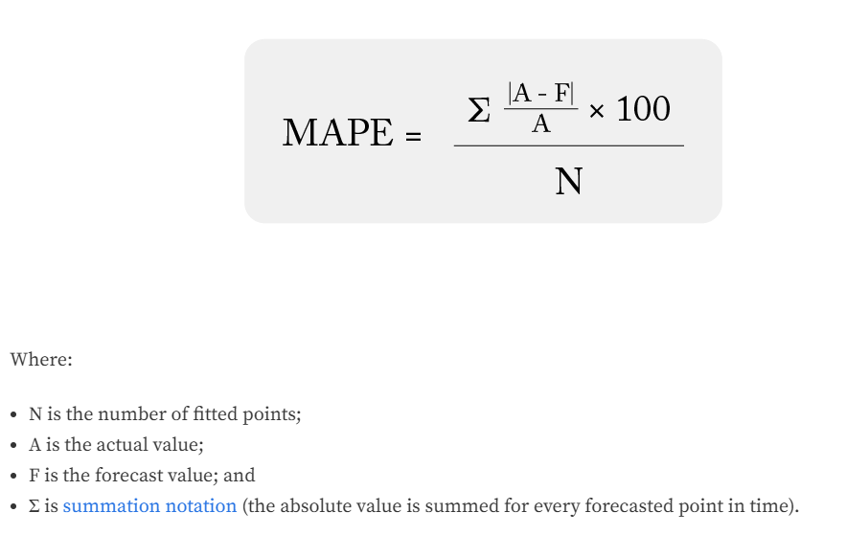
Model Forecast
Accuracy metric
Science Presentation
https://arize.com/blog-course/mean-absolute-percentage-error-mape-what-you-need-to-know/#:~:text=Once%20we%20calculate%20the%20absolute,our%20mean%20absolute%20percentage%20error.
Notes:
Mean absolute percentage error measures the average magnitude of error produced by a model, or how far off predictions are on average.

Slide 38
Model Forecast
Science Presentation
The model
Original ARIMA(1, 1, 1)
mape: 0.005842429079509394
1 - mape: 0.9941575709
Boxcox ARIMA(1,1,1)
mape: 0.11515008231150956
1-mape: 0.8848499177
Notes:
AR(1) coefficient ϕ1=0.3101\phi_1 = 0.3101ϕ1​=0.3101: This means that the previous value of the differenced series (yt−1′y_{t-1}'yt−1′​) has a positive relationship with the current value.
MA(1) coefficient θ1=−0.7492\theta_1 = -0.7492θ1​=−0.7492: This means that the previous error term (ϵt−1\epsilon_{t-1}ϵt−1​) has a negative influence on the current value of the differenced series.
Sigma2 (Error Variance) σ2=0.7747\sigma^2 = 0.7747σ2=0.7747: This is the variance of the residuals (errors). A higher value of sigma2 indicates larger variability in the errors.

Slide 39
Model Overview
Science Presentation
SARIMA
https://github.com/egorhowell/Youtube/blob/main/Time-Series-Crash-Course/16.%20Moving%20Average%20Models.ipynb

Slide 40
Model Overview
Science Presentation
SARIMA
Seasonal
https://github.com/egorhowell/Youtube/blob/main/Time-Series-Crash-Course/16.%20Moving%20Average%20Models.ipynb
Notes:
The multiplicative seasonal ARIMA model is often denoted as (P, D, Q)s x (p, d, q) where

Slide 41
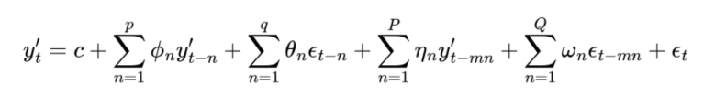
Model Overview
Science Presentation
Seasonal
y’: differenced time series
P: seasonal auto-regressors
ω: seasonal autoregressive components
Q: number of seasonal moving-average components
η: seasonal forecast errors
m: length of season
Notes:
y’: differenced time series, the number of differencing applied is noted as d
ϕ: coefficients of the autoregressive components (lags)
p: number of autoregressive components
ε: forecast error terms, the moving-average components
θ: coefficients of the lagged forecast errors
q: number of lagged error components
The multiplicative seasonal ARIMA model is often denoted as (P, D, Q)s x (p, d, q) where , s is seasonal lag

Slide 42
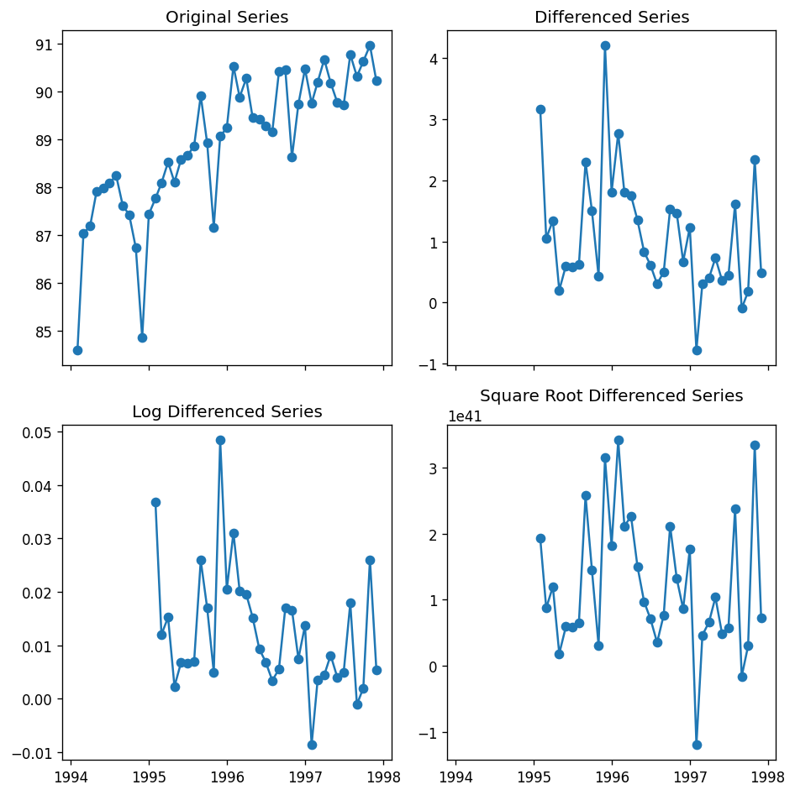
Preprocessing
Science Presentation
Differencing (12) & Transformations

Slide 43
Model Fitting
Original AQI with 12 order differencing
Science Presentation
SARIMAX Results
==========================================================================================
Dep. Variable: y No. Observations: 36
Model: SARIMAX(3, 2, 0)x(0, 1, 0, 12) Log Likelihood -36.162
Date: Sat, 01 Mar 2025 AIC 80.324
Time: 18:25:49 BIC 84.688
Sample: 01-01-1994 HQIC 81.352
- 12-01-1996
Covariance Type: opg
==============================================================================
coef std err z P>|z| [0.025 0.975]
------------------------------------------------------------------------------
ar.L1 -1.4593 0.235 -6.210 0.000 -1.920 -0.999
ar.L2 -1.0488 0.322 -3.260 0.001 -1.679 -0.418
ar.L3 -0.3625 0.294 -1.234 0.217 -0.938 0.213
sigma2 1.4162 0.550 2.573 0.010 0.337 2.495
===================================================================================
Ljung-Box (L1) (Q): 0.10 Jarque-Bera (JB): 0.26
Prob(Q): 0.75 Prob(JB): 0.88
Heteroskedasticity (H): 0.45 Skew: 0.14
Prob(H) (two-sided): 0.31 Kurtosis: 2.55
===================================================================================

Slide 44
Model Fitting
Boxcox AQI with 12 order differencing
Science Presentation
SARIMAX Results
===========================================================================================
Dep. Variable: y No. Observations: 36
Model: SARIMAX(0, 2, 3)x(0, 1, 0, 12) Log Likelihood -2107.282
Date: Sat, 01 Mar 2025 AIC 4222.564
Time: 18:25:53 BIC 4226.928
Sample: 01-01-1994 HQIC 4223.592
- 12-01-1996
Covariance Type: opg
==============================================================================
coef std err z P>|z| [0.025 0.975]
------------------------------------------------------------------------------
ma.L1 -1.5708 0.305 -5.156 0.000 -2.168 -0.974
ma.L2 0.7552 0.413 1.829 0.067 -0.054 1.565
ma.L3 -0.1692 0.206 -0.820 0.412 -0.574 0.235
sigma2 1.095e+82 nan nan nan nan nan
===================================================================================
Ljung-Box (L1) (Q): 0.00 Jarque-Bera (JB): 2.82
Prob(Q): 0.98 Prob(JB): 0.24
Heteroskedasticity (H): 0.98 Skew: 0.88
Prob(H) (two-sided): 0.98 Kurtosis: 2.97
===================================================================================

Slide 45
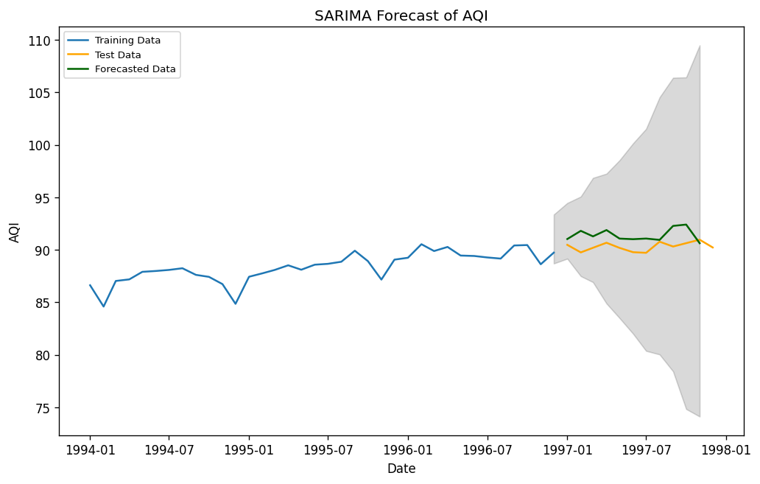
Model Forecast
Science Presentation
Figure 1: SARIMA forecast for original AQI

Slide 46
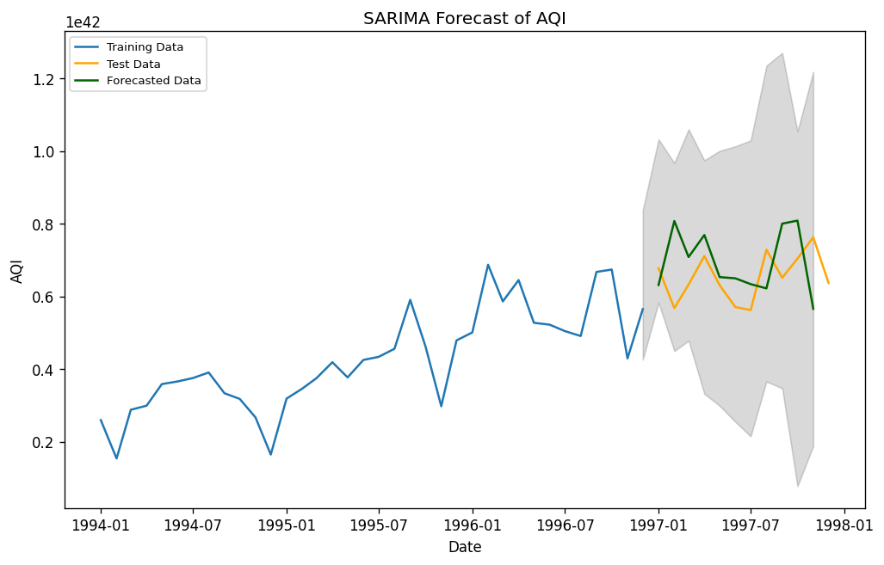
Model Forecast
Science Presentation
Figure 1: SARIMA forecast for boxcox AQI

Slide 47
Model Forecast
Science Presentation
The model
Original SARIMA(3,2,0)(0,1,0)[12]
mape: 0.0131225484
1 - mape: 0.9868774516
Boxcox SARIMA(0,2,3)(0,1,0)[12]
mape: 0.16134812616182803
1-mape: 0.8386518738
Notes:
(p, d, q): These are the non-seasonal components of the ARIMA model.
p (AR term): The number of lag observations included in the model (AutoRegressive part).
d (Differencing term): The number of times the data needs to be differenced to make it stationary.
q (MA term): The number of lagged forecast errors used in the model (Moving Average part).
(P, D, Q): These are the seasonal components of the SARIMA model.
P: The number of seasonal autoregressive terms.
D: The number of seasonal differences.
Q: The number of seasonal moving average terms.
[s]: This represents the length of the seasonal cycle
Summary: Quality control methods and management protocols have been highly effective for manufacturing companies. In this example, we have seen that continuous improvement also needs to reflect the reality of a manufacturing process. That is, the effect of seasonal variations, while they exist, should be incorporated in QA schemes. Despite a strong seasonal trend in production, the seasonal variation in quality seemed to disappear in the final year, suggesting that using the right tools to analyze a problem can resolve it.

Slide 48
Appendix
Science Presentation
Kaggle
Egor Howell
Statistical Consulting
https://www.kaggle.com/code/prashant111/arima-model-for-time-series-forecasting
https://github.com/egorhowell/Youtube/blob/main/Time-Series-Crash-Course/17.%20ARIMA.ipynb
Javier Cabrera, Andrew McDougall
Python Packages
Arize
Pandas
Numpy
Matplotlib
seaborn
Statsmodels
Scipy
pmdarima
https://arize.com/blog-course/mean-absolute-percentage-error-mape-what-you-need-to-know/#:~:text=Once%20we%20calculate%20the%20absolute,our%20mean%20absolute%20percentage%20error.

